Slide 1
Assignment no. 1
Abhijit Ramesh Patil

Slide 2
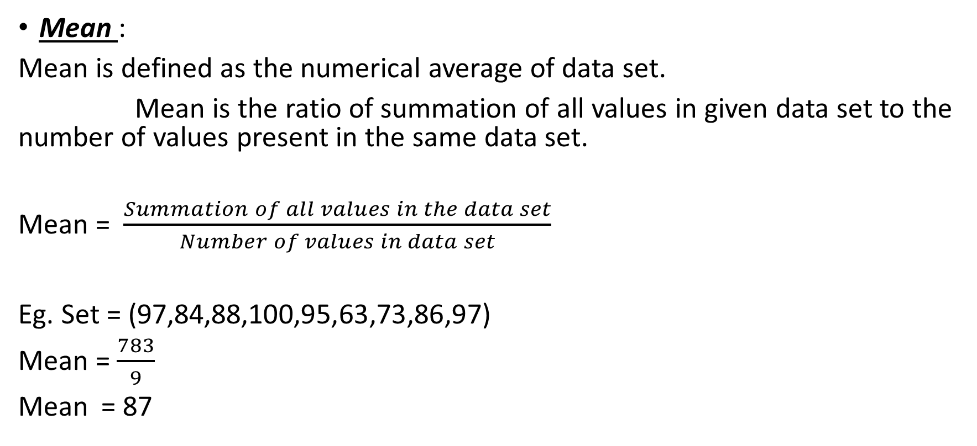
1) Define Mean, Median and Mode
Mean :
Mean is defined as the numerical average of data set.
Mean is the ratio of summation of all values in given data set to the number of values present in the same data set.
Mean = $\frac{Summation of all values in the data set}{Number of values in data set}$
Eg. Set = (97,84,88,100,95,63,73,86,97)
Mean = $\frac{783}{9}$
Mean = 87

Slide 3
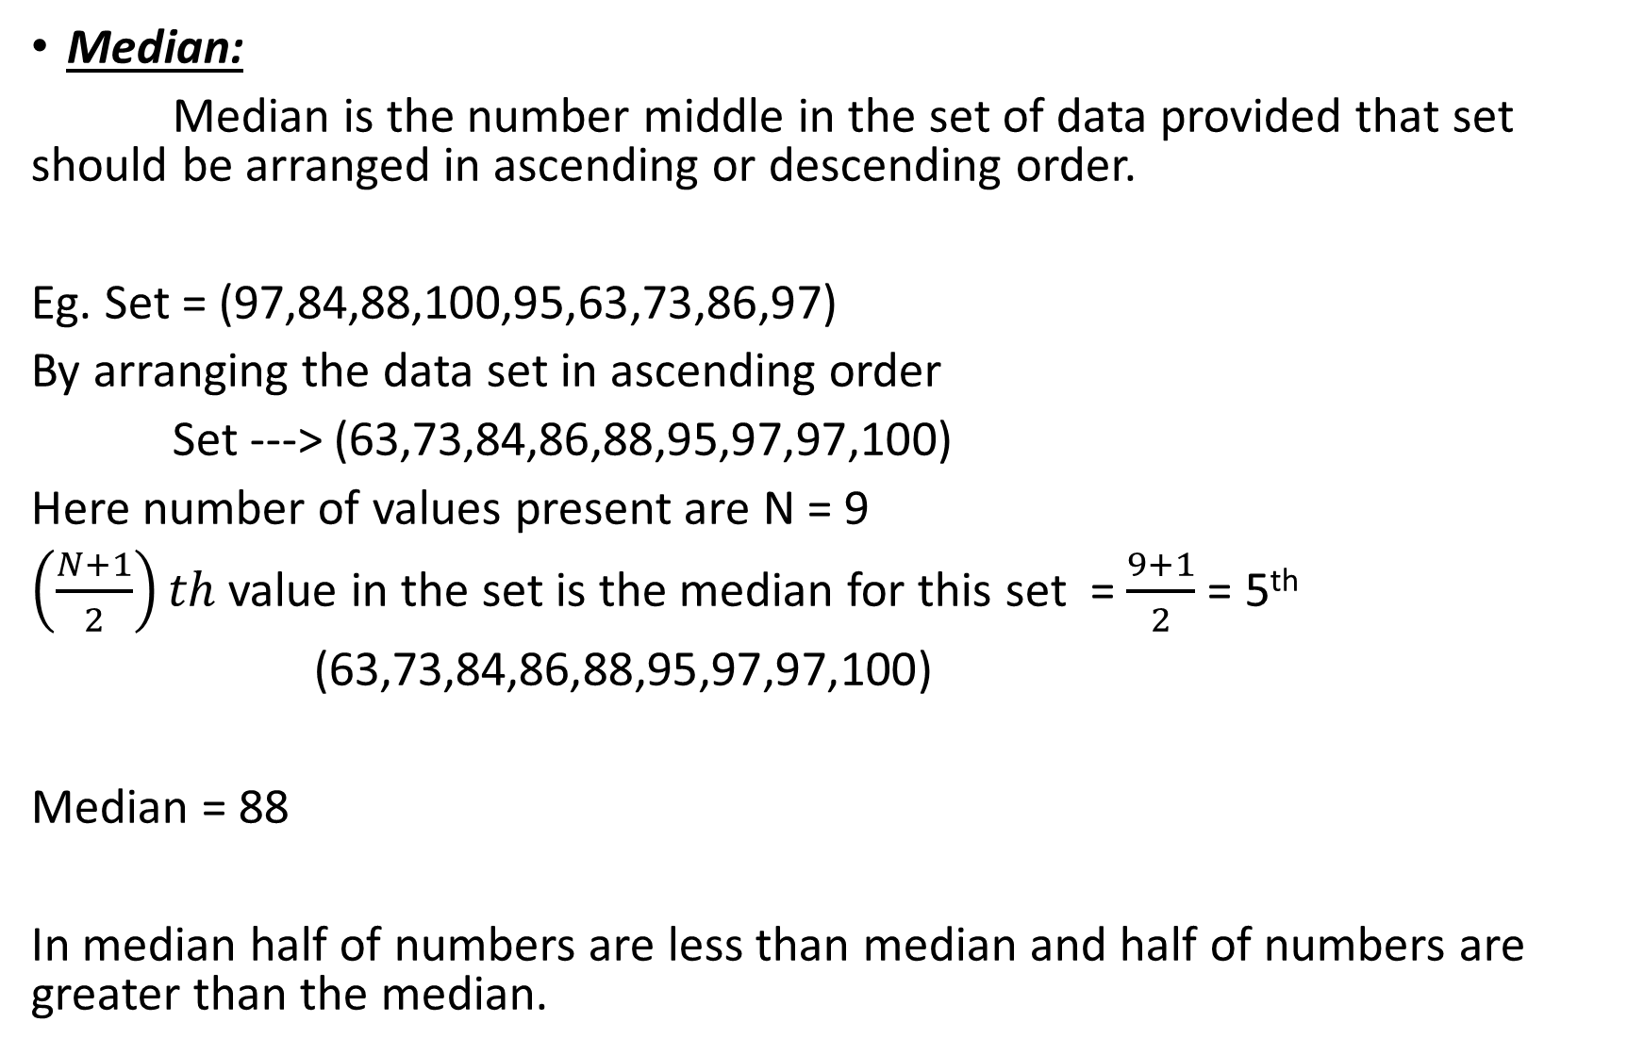
Median:
Median is the number middle in the set of data provided that set should be arranged in ascending or descending order.
Eg. Set = (97,84,88,100,95,63,73,86,97)
By arranging the data set in ascending order
Set ---> (63,73,84,86,88,95,97,97,100)
Here number of values present are N = 9
$\left(\frac{N+1}{2}\right)th$ value in the set is the median for this set = $\frac{9+1}{2}$ = 5th
(63,73,84,86,88,95,97,97,100)
Median = 88
In median half of numbers are less than median and half of numbers are greater than the median.

Slide 4
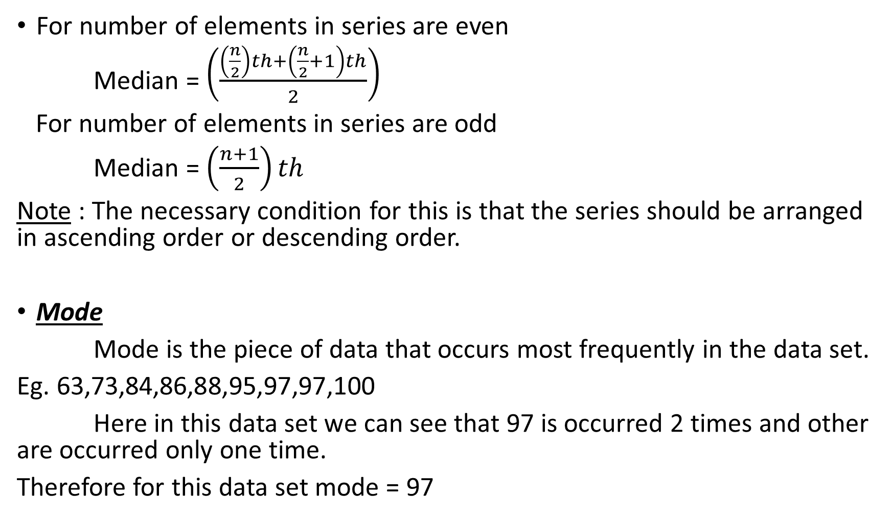
For number of elements in series are even
Median = $\left(\frac{\left(\frac{n}{2}\right)th+\left(\frac{n}{2}+1\right)th}{2}\right)$
For number of elements in series are odd
Median = $\left(\frac{n+1}{2}\right)th$
Note : The necessary condition for this is that the series should be arranged in ascending order or descending order.
Mode
Mode is the piece of data that occurs most frequently in the data set.
Eg. 63,73,84,86,88,95,97,97,100
Here in this data set we can see that 97 is occurred 2 times and other are occurred only one time.
Therefore for this data set mode = 97

Slide 5
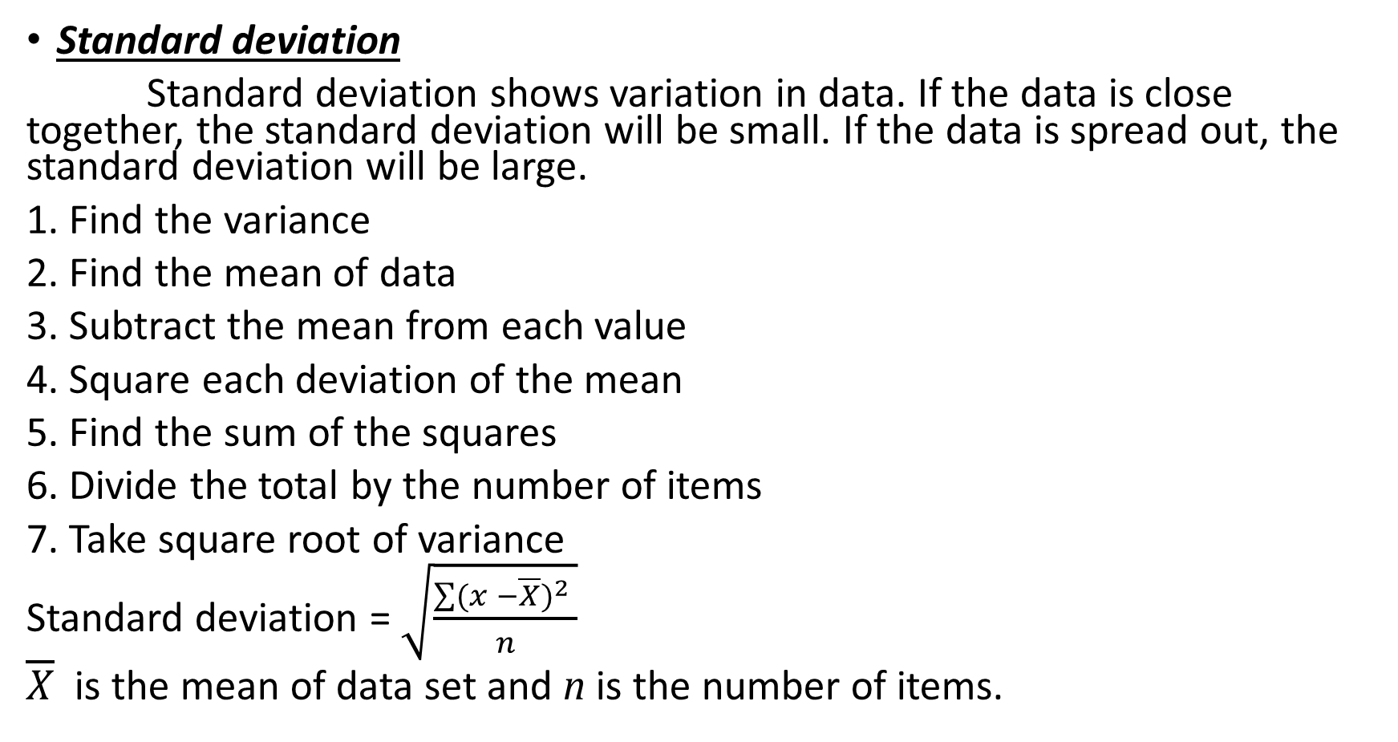
2) Define standard deviation and variance
Standard deviation
Standard deviation shows variation in data. If the data is close together, the standard deviation will be small. If the data is spread out, the standard deviation will be large.
1. Find the variance
2. Find the mean of data
3. Subtract the mean from each value
4. Square each deviation of the mean
5. Find the sum of the squares
6. Divide the total by the number of items
7. Take square root of variance
Standard deviation = $\sqrt{\frac{\sum{{(x −\overline{X})}^{2} }}{n}}$
$\overline{X}$ is the mean of data set and n is the number of items.

Slide 6
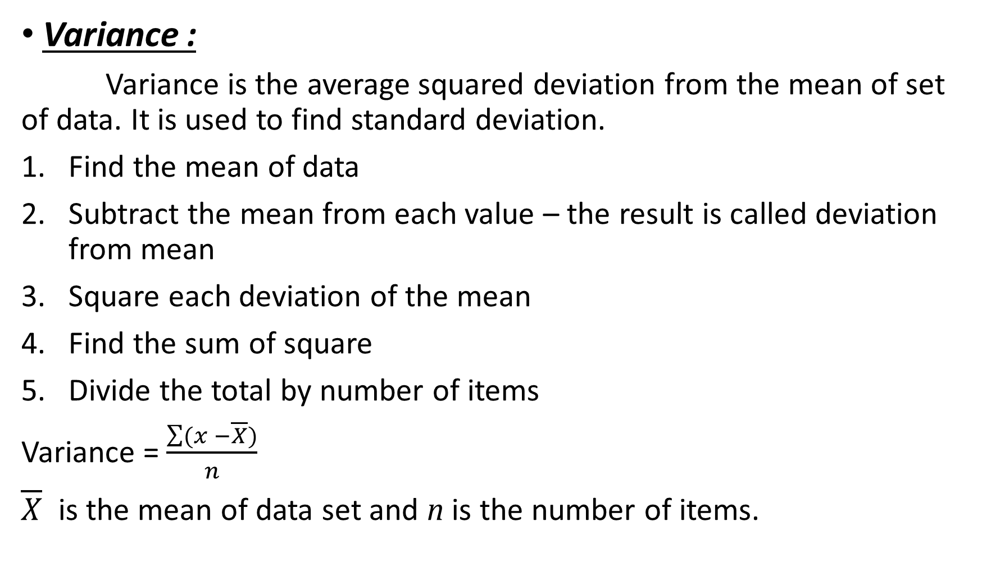
Variance :
Variance is the average squared deviation from the mean of set of data. It is used to find standard deviation.
Find the mean of data
Subtract the mean from each value – the result is called deviation from mean
Square each deviation of the mean
Find the sum of square
Divide the total by number of items
Variance = $\frac{\sum{(x −\overline{X})}}{n}$
$\overline{X}$ is the mean of data set and n is the number of items.

Slide 7
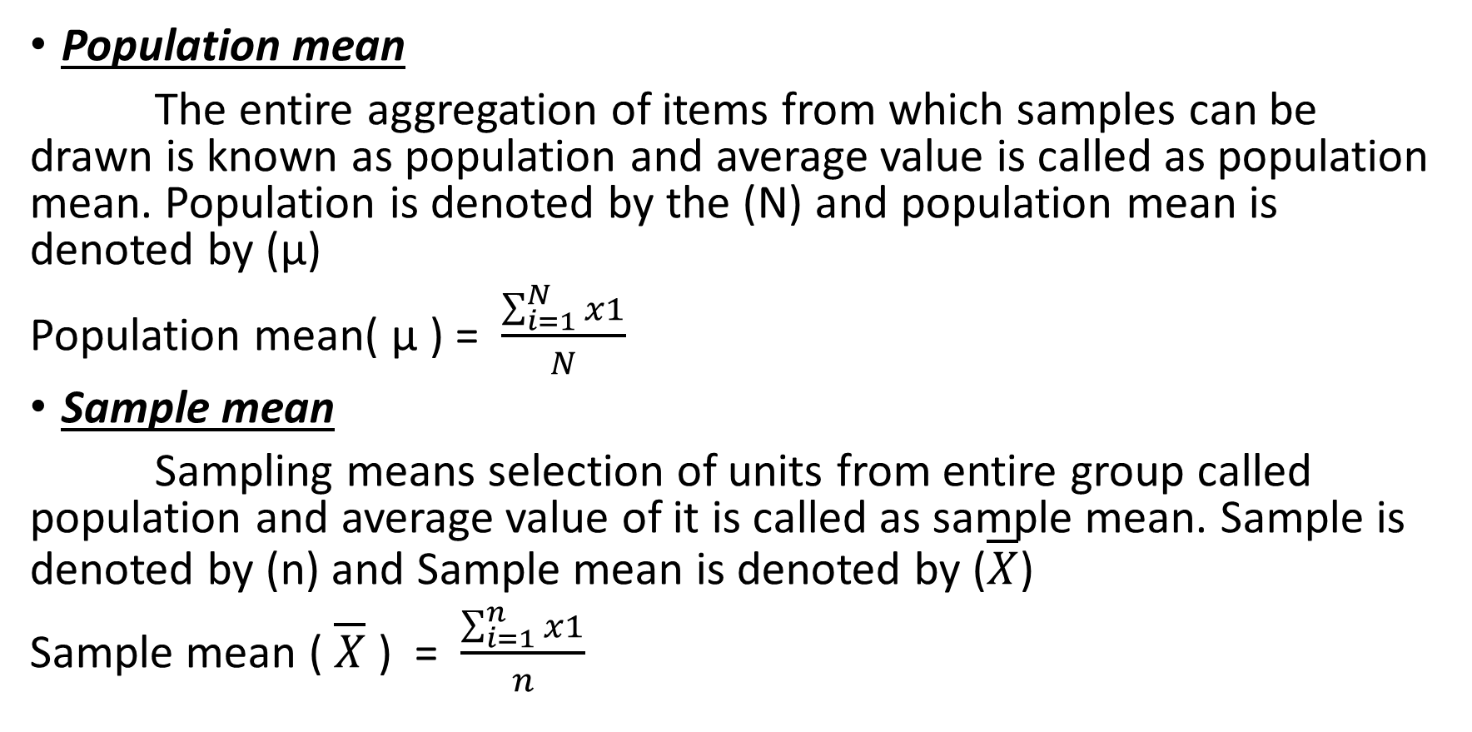
Define population mean and sample mean
Population mean
The entire aggregation of items from which samples can be drawn is known as population and average value is called as population mean. Population is denoted by the (N) and population mean is denoted by (µ)
Population mean( µ ) = $\frac{\sum_{i=1}^{N}{x1}}{N}$
Sample mean
Sampling means selection of units from entire group called population and average value of it is called as sample mean. Sample is denoted by (n) and Sample mean is denoted by ($\overline{X}$)
Sample mean ( $\overline{X}$ ) = $\frac{\sum_{i=1}^{n}{x1}}{n}$

Slide 8
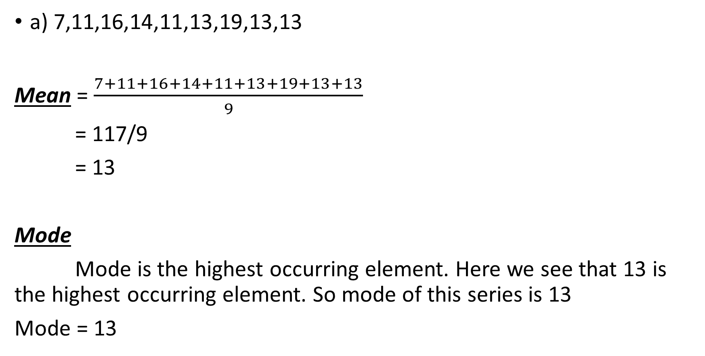
Find mean, mode, median, standard deviation
a) 7,11,16,14,11,13,19,13,13
Mean = $\frac{7+11+16+14+11+13+19+13+13}{9}$
= 117/9
= 13
Mode
Mode is the highest occurring element. Here we see that 13 is the highest occurring element. So mode of this series is 13
Mode = 13

Slide 9
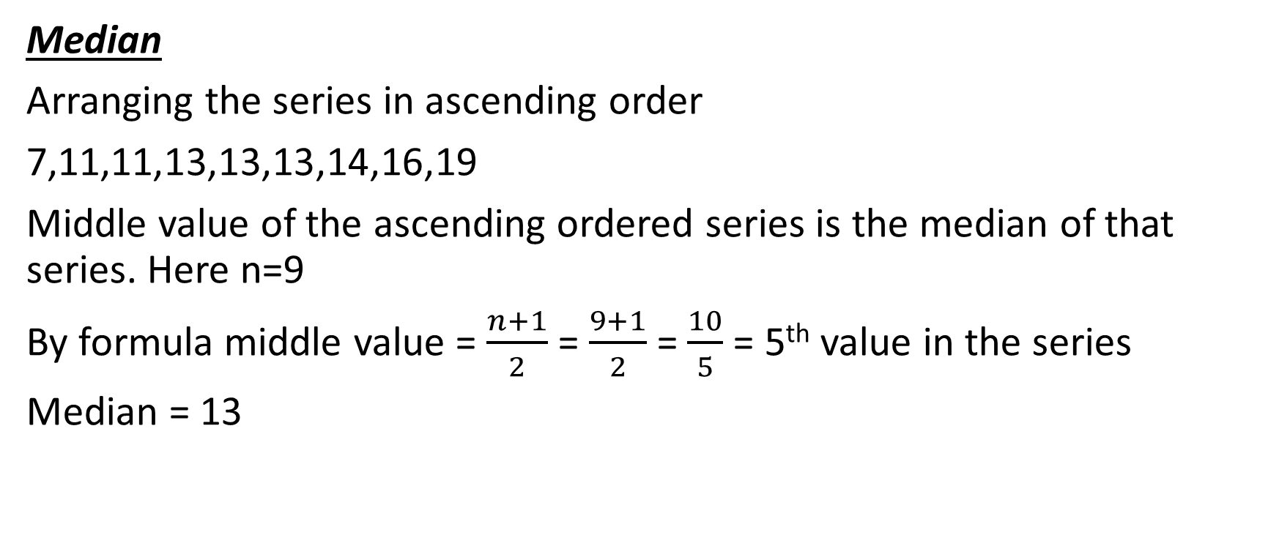
Median
Arranging the series in ascending order
7,11,11,13,13,13,14,16,19
Middle value of the ascending ordered series is the median of that series. Here n=9
By formula middle value = $\frac{n+1}{2}$ = $\frac{9+1}{2}$= $\frac{10}{5}$ = 5th value in the series
Median = 13

Slide 10
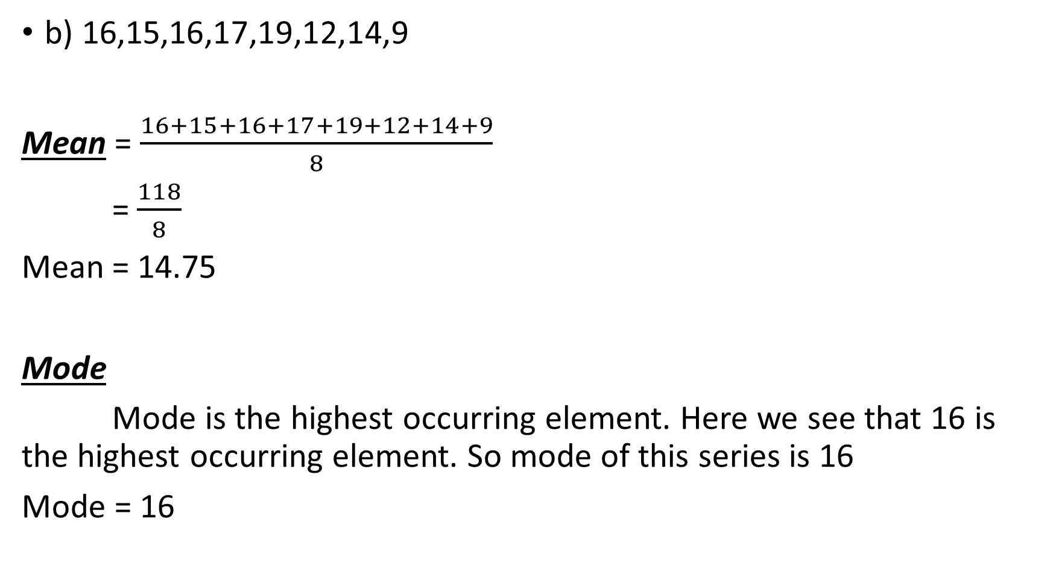
b) 16,15,16,17,19,12,14,9
Mean = $\frac{16+15+16+17+19+12+14+9}{8}$
= $\frac{118}{8}$
Mean = 14.75
Mode
Mode is the highest occurring element. Here we see that 16 is the highest occurring element. So mode of this series is 16
Mode = 16

Slide 11
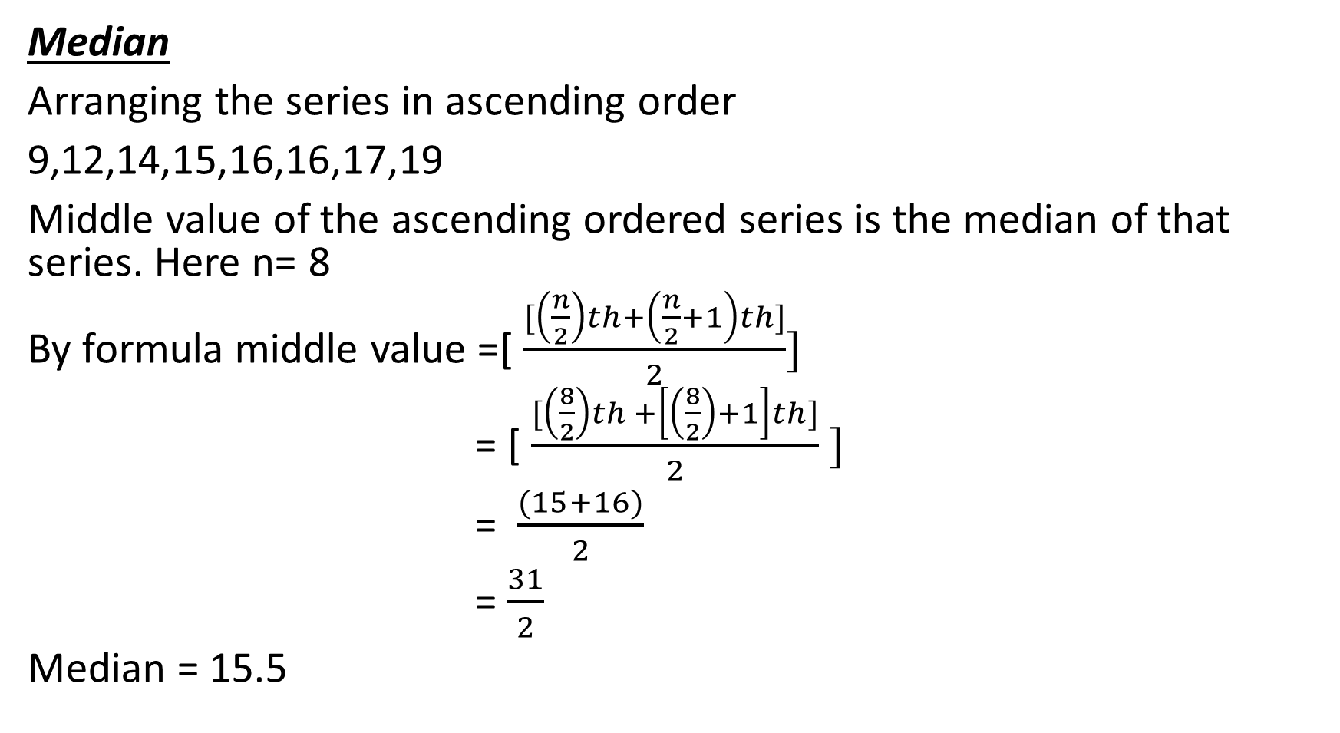
Median
Arranging the series in ascending order
9,12,14,15,16,16,17,19
Middle value of the ascending ordered series is the median of that series. Here n= 8
By formula middle value =[ $\frac{[\left(\frac{n}{2}\right)th+\left(\frac{n}{2}+1\right)th]}{2}]$
= [ $\frac{[\left(\frac{8}{2}\right)th +\left[\left(\frac{8}{2}\right)+1\right]th]}{2} ]$
= $\frac{(15+16)}{2}$
= $\frac{31}{2}$
Median = 15.5

Slide 12
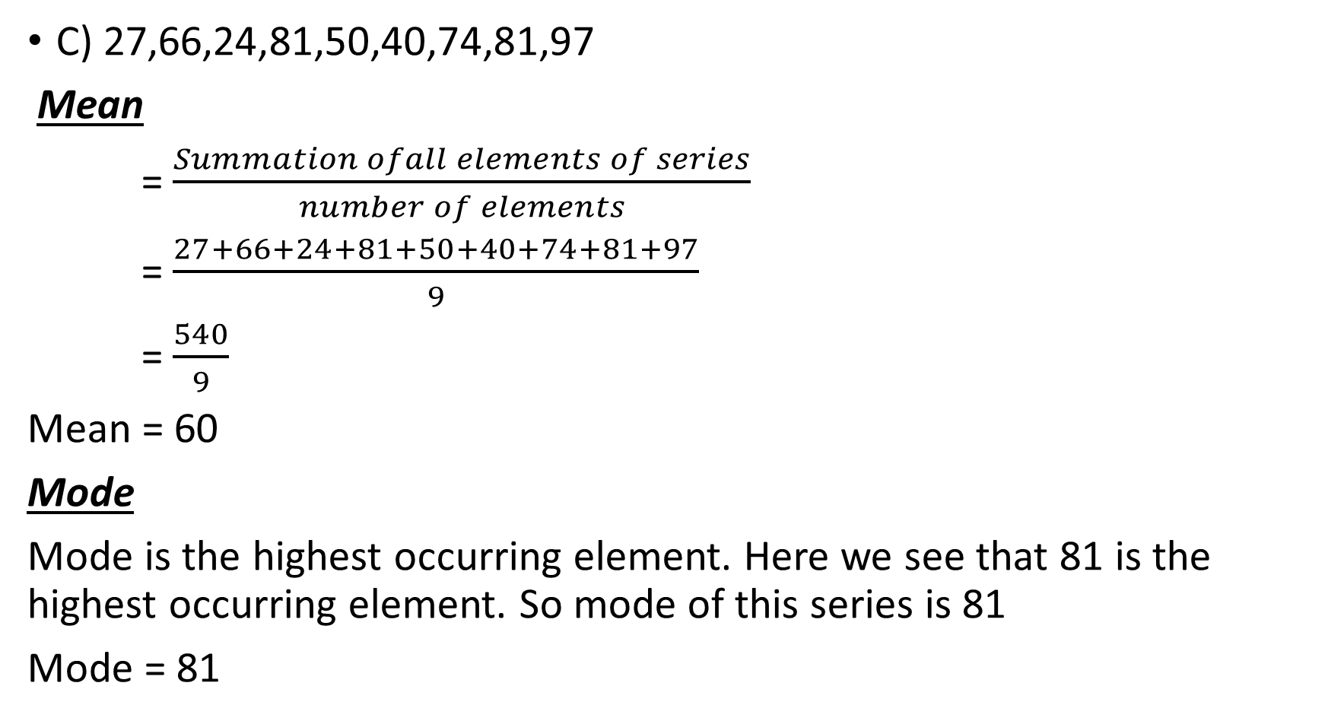
C) 27,66,24,81,50,40,74,81,97
Mean
= $\frac{Summation ofall elements of series}{number of elements}$
= $\frac{27+66+24+81+50+40+74+81+97}{9}$
= $\frac{540}{9}$
Mean = 60
Mode
Mode is the highest occurring element. Here we see that 81 is the highest occurring element. So mode of this series is 81
Mode = 81

Slide 13
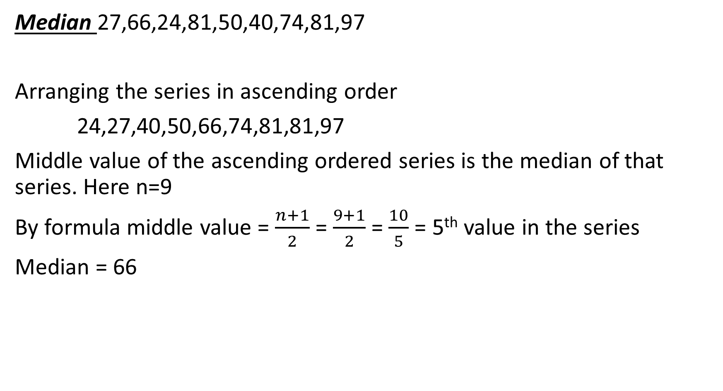
Median 27,66,24,81,50,40,74,81,97
Arranging the series in ascending order
24,27,40,50,66,74,81,81,97
Middle value of the ascending ordered series is the median of that series. Here n=9
By formula middle value = $\frac{n+1}{2}$ = $\frac{9+1}{2}$= $\frac{10}{5}$ = 5th value in the series
Median = 66

